Slide 1
The Minor Prophets
Anything But Minor
Notes:
I’m looking forward to this study as Lord Wiling we go through each of the 12 minor prophets one at a time and mostly in chronological order.
If you joined us previously hopefully you remember this but let me ask…
There are 4 major ones and 12 minor ones? What is the difference between a major prophet and a minor prophet? This is kind of a trick question…the only difference between the two is the length of the book…that’s the only difference.

Slide 2
The Minor Prophets: Joel
An overview
Notes:
So if you joined us for the book of Jonah we started that by talking about Jonah being unique for it not being based on the message that the prophet was to deliver but on the actions of Jonah and the actions of God. Forgiveness, compassion and grace offered to enemies by God and a heart problem by Jonah.
We talked about the repentance shown by 3 different groups and how it was a heart that had eyes and feet. Eyes to see and agree with God and feet to walk away (turn away) from sin and to God.
Now I start there because Joel is going to also be unique to the minor prophets but for a totally different reason. We will take a look at the theme of the book to listen for during this overview and it will match or continue the repentance theme that we saw in Jonah.

Slide 3
The Minor Prophets: Joel
Time and dates – not the focus
Notes:
Now the reason Joel is unique is that we don’t actually know when for sure it was written. It’s also missing the normal laundry list of sins that the prophets were known for calling the people out on.
So instead the focus is on the call to repent. You will be familiar with the cry when you hear…Blow the trumpet in Zion. Sound the alarm on His holy mountain. That comes from the book of Joel.
When we see this mention in chapter 2 I can tell you that it’s the only reference in the 3 chapter book that gives a hint that can be used to date the book.
Zion is a synonym for Jerusalem as well as for the Land of Israel as a whole so that’s not really a big help. Again focus on the call to repent as that is the common thread that we will see throughout this entire series.

Slide 4
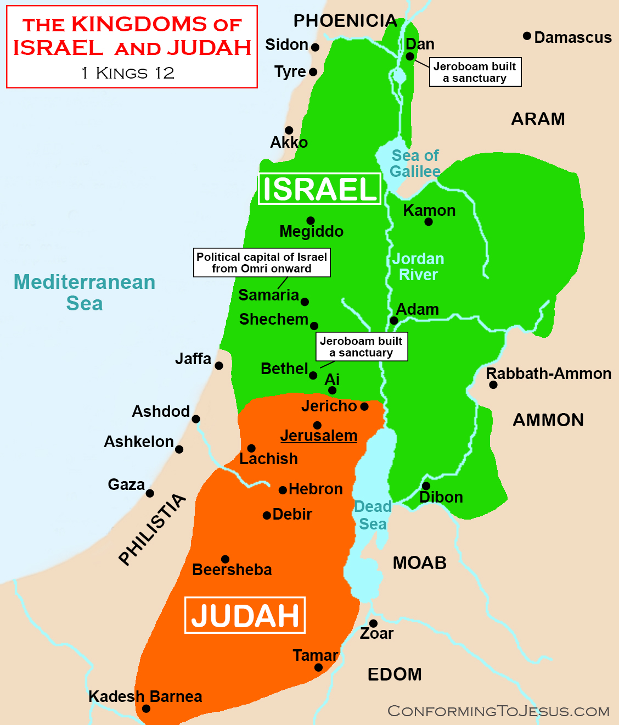
12 minor prophets cover time from about 830 BC to about 430 BC
Event | Year
Promise to Abraham | 1925 BC
Joseph’s Family in Egypt | 1700 BC
Moses Leading the people out of Egypt | 1280 BC
Joshua Leading the people into the promised land | 1240 BC
People ruled by “judges” | 1220 BC
People ruled by kings (all tribes together) | 1050 BC
Kingdom split into Northern and Southern Kingdom’s | 930 BC
Northern Kingdom conquered | 722 BC
Southern Kingdom exiled | 586 BC
Remnant back in Jerusalem | 538 BC
Old Testament ends with 400 silent years | 420 BC
Notes:
I’ll put the list of prophets back up next with the approximate dates but one of the things to know is that any way you look at it the fit will still fall mostly within the 800 BC to 400 BC timeframe. So on the list we are still in the area of dealing with the split in kingdoms towards the very end of the old testament.
Just as a reminder the split of the Northern and Southern kingdoms is between Jerico to the south with Jerusalem as the capital and Ai / Bethel to the North with Samaria as the capital.

Slide 5
Prophets split into Captive Periods - Pre-exilic and post-exilic
Assyrian Period
Jonah (790 – 770)
Joel (????)
Amos (780 – 740
Hosea (760 – 720)
ISAIAH (745 – 695)
Micah (740 – 700)
Zephaniah (639 – 608)
Nahum (630 – 610)
Babylonian Period
Persian Period
JEREMIAH (626 – 586)
Habakkah (606 – 586)
EZEKIAL (592 – 570)
Obadiah (586 – 583
DANIEL (605 – 534)
Haggai (520 – 516)
Zechariah (520 – 516)
Malachi (450 – 400)
Joel (????)
Notes:
Here’s why there is a problem with where Joel belongs on this prophets list. Normally with every prophet you will see a king or kings mentioned. That usually will automatically date it. There are no kings or reference to kings mentioned in Joel
Sometimes it will list specifically Judah or Israel. After the split Judah referred to the southern kingdom that had the tribes of Judah and Benjamin. Israel referred to the northern kingdom containing the other 10 tribes. You often will see Israel referred to Ephraim as well. That also refers to the Northern kingdom. There is no reference to either kingdom here. When he mentions Zion it could be before or after the fall of both the southern and northern kingdoms
The only thing we really know for sure about Joel is who his father was and that he was believed to be from the region of Judea, so from the southern kingdom…and of course that he was identified as a prophet for God.
A cool thing about his name…In Hebrew it is “Ya…El” which means Jehovah is God or the Lord is God.
One other notation you might see in studying is some will call him a pre-exilic prophet.

Slide 6
835 BC 430 BC
Clues lead to the key message either way
Notes:
So two basic train of thoughts as to where Joel fits…but most everyone agrees that he fits roughly either after the kingdom split but before the Northern kingdom’s fall or well after the fall of the southern kingdom where the remnant has returned to Jerusalem.
The camp that believes him to be before the Northern kingdom is overthrown points to the picture in chapter two of an army coming in to wipe out Israel. Assyria would be the nation to come in and do that in 722 – 721 bc. The northern 10 tribes would be totally wiped out and removed from the land in captivity. Everything would line up historically. Often Joel, Amos and Hosea are looked at together because of the message…

Slide 7
835 BC 430 BC
Clues lead to the key message either way
Notes:
Those who go against this view say that Assyria would likely have been mentioned if they were the nation Joel is referring to.
The other camp that puts him towards the very end after the remnant returns due to the fact that Joel either sites or uses similar language or the same warnings as some of the later prophets such as Amos, Malachi, Obadiah, Ezekiel, Zephaniah, Nahum and Isaiah.

Slide 8
The Key To The book: Listen for this!
Prayer “P”
Return “R”
Repent
Rend
Revival comes AFTER Repentance
Notes:
Again the key here is not the focus on the dates but on the message. I’m going to call Joel God’s “PR” man based on the simple message…here’s what we listen for as a theme to go along with what we already covered in Jonah…
The message will be (Read slide)
And a secondary key will be that revival doesn’t come before repentance.
Scholars also mention that Joel could have been a priest as well just based on the language and his leadership of the priests that is pointed out in the book.

Slide 9
2 Chronicles 7:14
“ if my people who are called by my name humble themselves, and pray and seek my face and turn from their wicked ways, then I will hear from heaven and will forgive their sin and heal their land” ( 2 Chronicles 7:14 ).
Notes:
So the books of chronicles deal with the history lined out from Genesis through the judges, prophets and kings.
As such it lines out the disobedience and unfaithfulness of God’s people. It is believed that Ezra and possibly Nehemiah authored the books.
2 Chronicles 7:14 is likely to be familiar to you but the book of Joel will mirror what we see here…
Read verse.

Slide 10
Remember Isaiah?
(Joel has got to be related somewhere down the line!)
The Alarm is God’s Progressive Judgment
Notes:
So remember when Isaiah would refer to multiple time frames…sometimes in the same sentence?
The now, what’s coming and then what’s coming Revelation time. Joel will do some similar things. He will start with history, use that history to symbolically point to the future and then point to Revelation future.
The alarm he sounds is the progressive intensiveness of God’s wrath poured out.
With that picture lets start there.

Slide 11
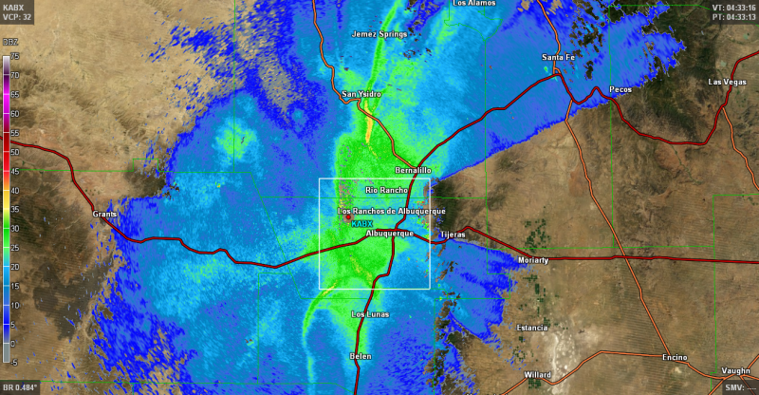
How Bad Can It Be?
Notes:
To understand the book of Joel we need to understand this lovely little locust. The picture on the right is an up close shot of one of these guys…they are usually about 2 inches long and have a wingspan that extends out to about 6 inches so you will know if one of these gets in your hair.
The desert locust (Schistocerca gregaria) is a notorious species. Found in Africa, the Middle East, and Asia, this species inhabits an area of about six million square miles, or 30 countries, during a quiet period. During a plague, when large swarms descend upon a region, however, these locusts can spread out across some 60 countries and cover a fifth of Earth's land surface. Desert locust plagues threaten the economic livelihood of a tenth of humans.
A desert locust swarm can be 460 square miles in size and pack between 40 and 80 million locusts into less than half a square mile. Each locust can eat its weight in plants each day, so a swarm of such size would eat 423 million pounds of plants every day. To put it into context, a swarm the size of Paris can eat the same amount of food in one day as half the population of France.
The radar pic on the right was when a swarm showed up over Albequerque

Slide 12
Exodus 10
Where it Really Begins
Notes:
Another thing that scholars point out about Joel is that likely was very well versed in the old testament and that he likely expected that his readers should also have that base knowledge. So with that the story doesn’t really begin in Joel but in Exodus with the God delivering his people out of Egypt using the plagues.
Exodus 10 paints the picture for the backdrop of the book…again doesn’t matter the timeline but we know where it really began because of the comparison that will be given.
Turn in your bible to Exodus chapter 10….Exodus chapter 10. We will be reading verses 1 through 20.
Pay attention to the key phrase in verse 15…this will help to understand part of the mindset that Joel has in chapter 1.
Now look at Deuteronomy chapter 28

Slide 13
Deuteronomy 28
Blessings for Obedience and Curses for Disobedience
Notes:
So we can see how devastating it was to Egypt…now lets look at the promise of punishment for disobedience given to God’s people. Turn to Deuteronomy Chapter 28…we will start in verse 15 and read through the end of the chapter…
Now look back specifically at verses 28 through 42…

Slide 14
Preparation Homework
Read: 1:1 – 2:27
Notes:
Next week when we start in chapter 1 I want you to try and visualize the extent of the devastation described in Egypt (literally everything stripped bare, nothing green left) and the promise that the same curse would be put on God’s people.
Here’s your homework for next week: read all of chapter one and then start chapter 2 going through verse 27. We will pick back up there next week.
Thank You guys again for joining us tonight. Let’s pray.

